Slide 1
Smart parking system

Slide 2
Project sponsor: Ministry of Transportation
Project manager: Ahmed Mohamed abser
Purpose of the project:
1-Enhance the security with simplifying parking system.
2-Smart system that parks a number of vehicles with the least space possible
3-Solves the vandalism in special malls.

Slide 3
Scoop:
Parking zone should allocated either on-street or off-street.
The parking zone is identified by sign boards.
The on-street parking zone will have no obstructions on road.
LED signboards will be installed at the entry point of the parking zone.
Real time vacancy availability will be displayed on LED signboards at the entry.
Vehicle occupancy detectors installed on the ground ; one number each for a parking slot.
The vehicle detector is battery operated and will continuously sense the presence of vehicle in the slot and sends the data on the receiver wirelessly.
8) An application will be introduced to assist drivers .
9) the Application is only to help the drivers team at this stage, others such as support are out of the scope.

Slide 4
Business case :
The aim of this project is to create an application of a parking, android application and a web application
known as Smart Parking System. This system will be used by the special mall parking area.
The main purpose of this project is to develop a system that will ease the parking process
around special malls.
The system will help control the parking slot availability and also allow drivers to book for a parking slot before reaching the parking area.
The reservation will be for a certain period of time of which if the driver does not reach the parking area, their reservation will be expired.
The android application will help people book and see available parking slots , While the website will be used to see the available slot and also renew the reservation when they are expired.

Slide 5
Key deliverables
Smart Parking mobile application that will work on both android and IOS .
Smart Parking Website . (QR-Code Card (used on parking area)
Proto type of the building
Building system
Project milestones
Requirements Review : Requirements specifications are complete, correct, approved and suitable. By 10/10/2021
Critical design review: Detailed designs fully implement the system architecture, are approved and are suitable for input into the development of code By 15/11/2021
System test Review : The software product has passed system testing and is suitable for input into acceptance testing.by 15/11/2022
Product operational: The software is in use in its target operational environment.by 15/12/2022

Slide 6
Project resources :
Staff : 2 android developers ,2 IOS developers , 1 full Stack Web-Developer
Hardware : 5 laptops , 1 server
Software : Software licenses (Editors : AndroidStudio, AppCode , PHPStorm)
Budget :
• budget allocated for Software part: 250000 L.E
Constraints :
This project must be delivered within the specified budget
This project must be delivered on 1/1/2023
laptops or computers needed must be bought from( Apple & Microsoft companies)

Slide 7
Assumptions (required event must be occur every fixed period) :
will get all resources required.
All important stakeholders will come to the specified meetings.
All team members continue to the end of the project
High level risks :
Inaccurate estimates
Project team misunderstand requirements
High System maintenance costs
Loss of key personnel
Customer will not accept the software as delivered even though it meets all specifications
Selected technology is a poor match to the problem or customer
Projects within the program often need the same resources at the same time
Server Crashes

Slide 8
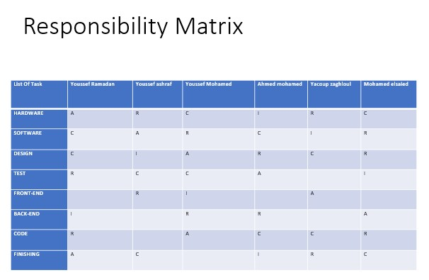

Slide 9
Parking system controlling
coding
Hardware
&
software
starting
finishing
1.1.1
Requirements
1.1.2
Policities
1.1.3
Study the project
1.1.4
planning
1.2.1
Procurements
1.2.2
Operating system
1.2.3
Testing devices
1.3.1
Dividing tasks
1.3.2
Coding tasks functions
1.3.3
Test function
1.3.4
Interface the application
1.4.1
The application
1.4.2
Explain & fixing errors
1.4.3
Finish the application
1.4.4
Install the application

Slide 10
ACTIVITY | DESCRIPTION | PLECEDING ACTIVITY | ACTIVITY TIME
A | HARDWARE | NONE | 2
B | SOFTWARE | A | 2
C | DESIGN | A | 4
D | TEST | B | 6
E | FRONT-END | C | 5
F | BACK-END | C | 3
G | CODE | D | 3
H | FINISHING | E , F , G | 2

Slide 11
TE
SOFTWARE
TEST
CODE
2
B
4
4
D
10
10
G
13
0
0
0
2
2
4
4
6
10
10
3
13
0
A
2
0
HARDWARE
0
2
2
FRONT-END
FINISH
6
E
11
13
H
15
2
0
DESIGN
8
5
13
13
2
15
2
C
6
2
4
4
8
BACK-END
6
F
9
4
10
3
13

Slide 12
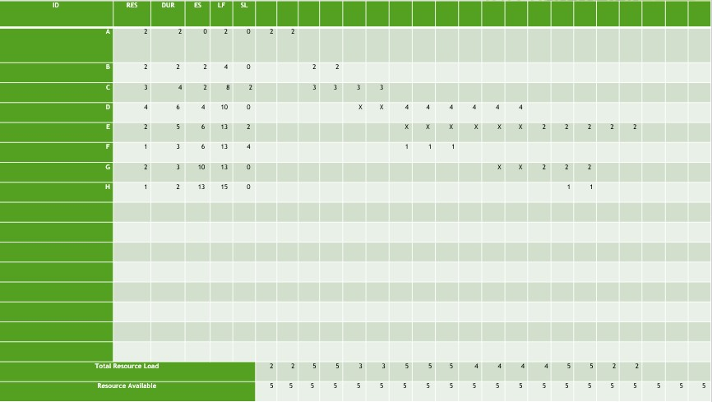

Slide 13
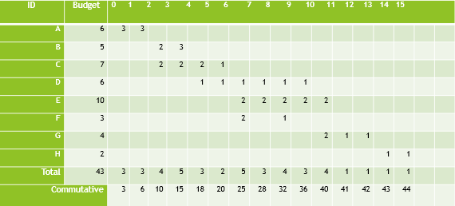
BASELINE BUDGET

Slide 14
Project team:
• Youssef Ramadan.
• Youssef ashraf.
• Youssef Mohamed.
• Jacoup zaghloul.
• Mohamed elsaied.
• Ahmed Mohamed abser

